Slide 1
Project
4
Leiwen Lin
HuitingTang
Xiaoli Zhao
Ziyi Zhao

Slide 2
Austin - 311 Unified Data (Utilities and City Services)
Introduction
Selection & Wrangling
Results
"Non-emergency 311 call systems, used increasingly in U.S. cities, offer a number of advantages. They give citizens a quick, convenient way to kvetch about problems in their neighborhoods, and get a response."
Pattern of Service Type by
Month
Owning Department
Methods
Mainly use SQL, plotting charts in Plotly

Slide 3
Introduction
Selection & Wrangling
Results
Utilities and City Services
Data size: 160 MB, 344,794 Rows, 24 columns
City: Austin, Texas
Duration: 01/03/2014 to present
Each row is one piece of city service request transaction
Basic info of Service (SR number, Owning Department, etc.)
Location info (geographic coordinates, ZIP code, etc)
Time Info (Created Date, Close_Date, etc.
Data Wrangling
Relative clean without missing value
Pandas
Retype
Import into PostgreSQL

Slide 4
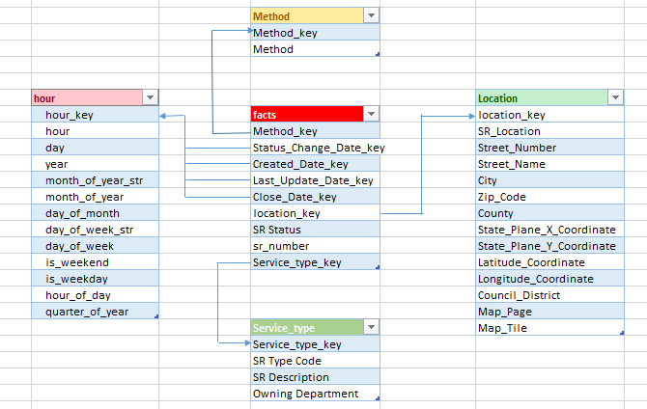
Star Schema
Introduction
Selection & Wrangling
Results

Slide 5
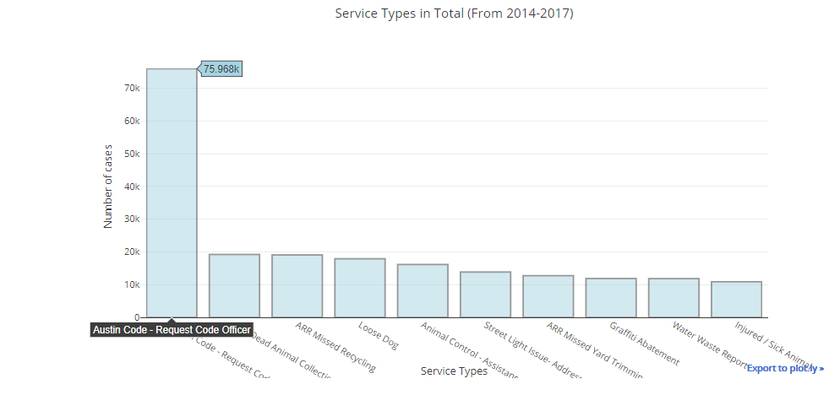
Overview
Introduction
Selection & Wrangling
Results
Austin Code Violations

Slide 6
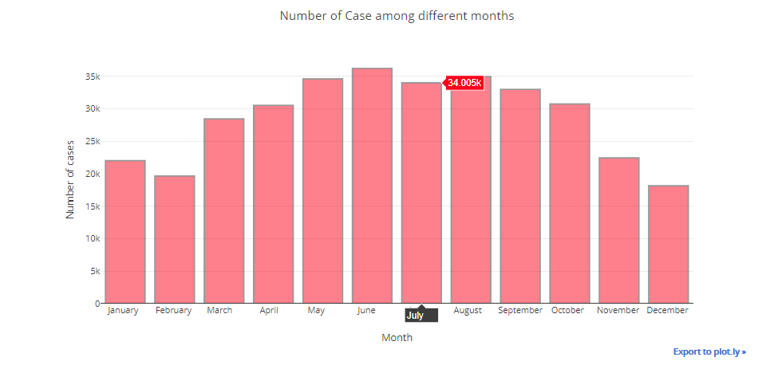
Cases by months
Introduction
Selection & Wrangling
Results

Slide 7
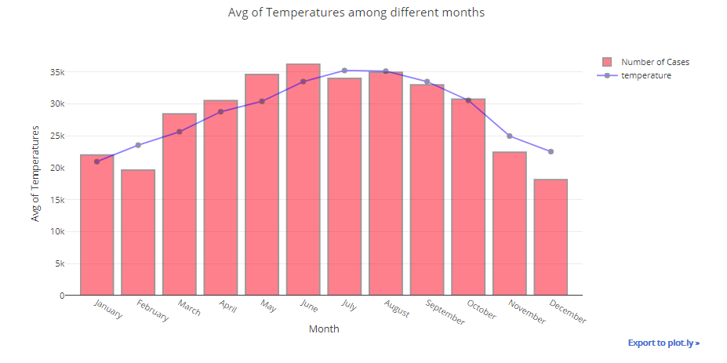
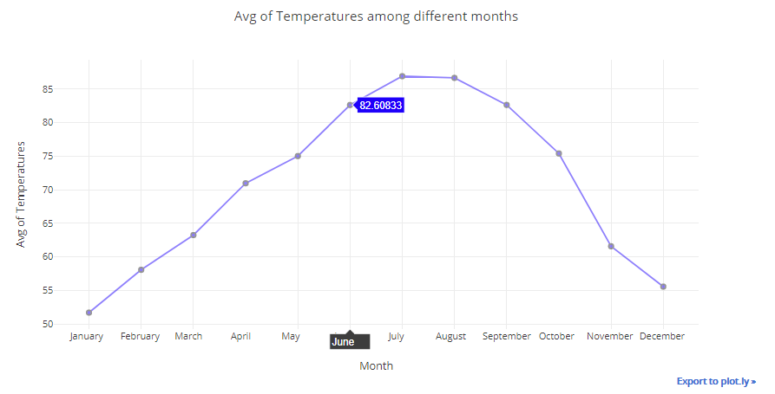
Augment: Temperature
Introduction
Selection & Wrangling
Results

Slide 8
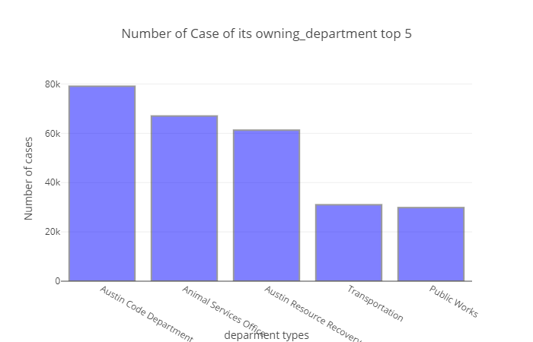
Cases by Owning department
Introduction
Selection & Wrangling
Results

Slide 9
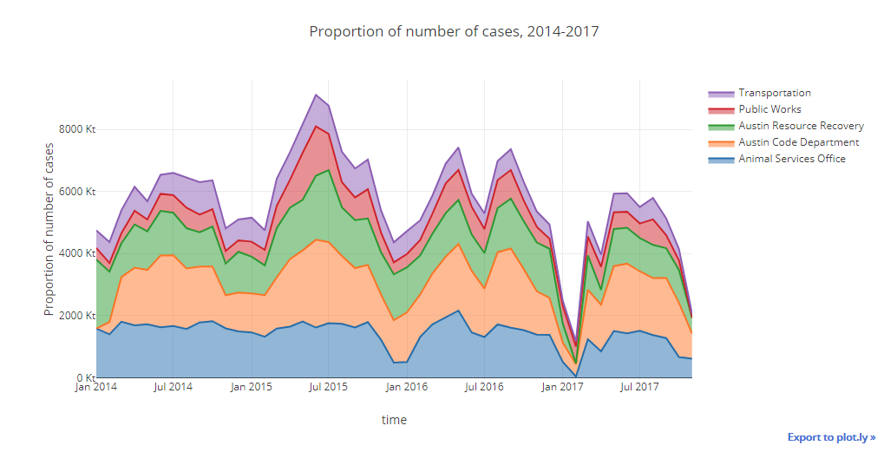
Numbers of cases by department
Introduction
Selection & Wrangling
Results

Slide 10

Thank you!
Data Source:
https://data.austintexas.gov/Utilities-and-City-Services/311-Unified-Data/i26j-ai4z
https://www.kaggle.com/grubenm/austin-weather/version/2/data

